Slide 1
Hello Everyone!!!

Slide 2
CSE 1200
Software Development-I
Group : 05
Arnab Saha
ID : 16-02-04-036
Shafin Rahman
ID : 16-02-04-040

Slide 3
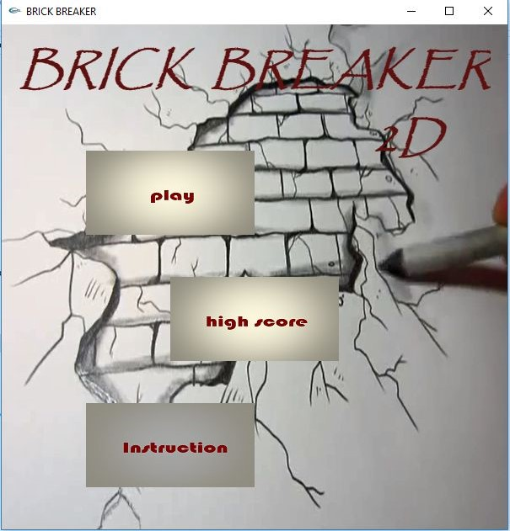
BRICK BREAKER 2d

Slide 4
Overview
Introduction To Brick Breaker Game
Sample Model
Game Description
System Requirements
Playing Method

Slide 5
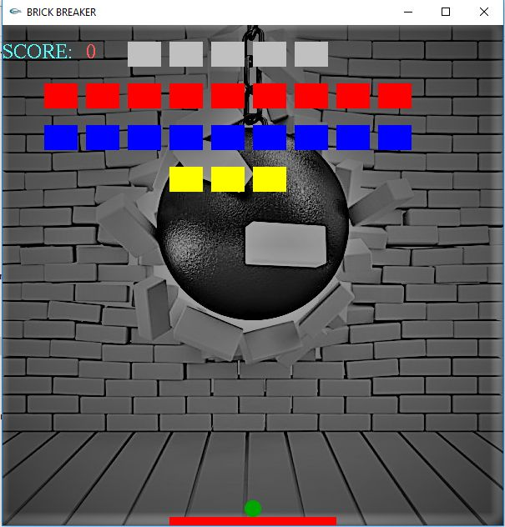
Introduction
Arcade game.
Single player game
Target and destroy bricks
Hit and gather score

Slide 6
Game Description
A layer of bricks lines stays the top third of the screen .
A ball travels across the screen.
Ball bouncing off the top and side walls of the screen.
The ball hits and destroys bricks.
Player has a paddle to bounce the ball.
Player destroys bricks to gather points.

Slide 7
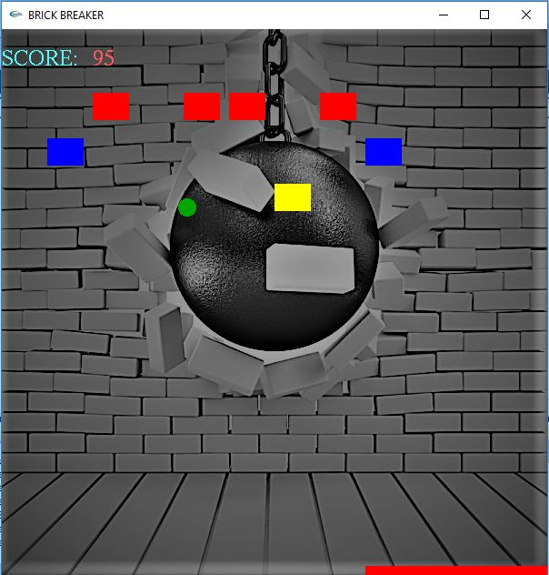

Slide 8
Playing Method
Using arrow key of keyboard
Moving right and left the paddle to bounce the ball
Destroying bricks using ball
Gathering points
Player will lose when the ball will fail to touch the paddleDestroy all bricks to obtain top score

Slide 9
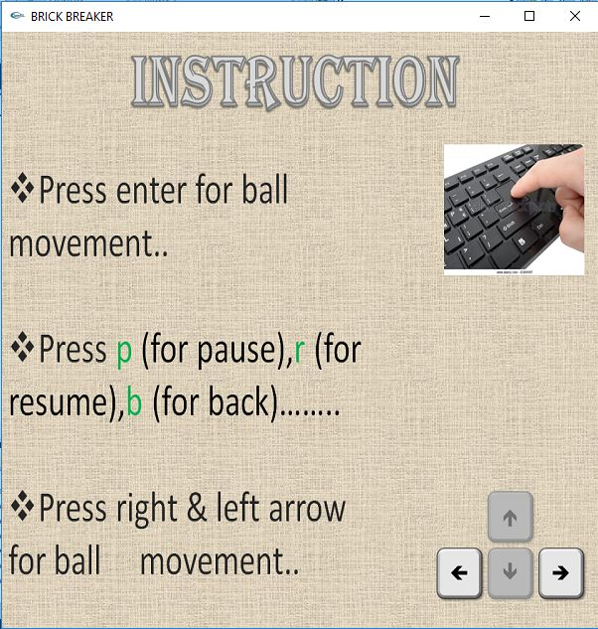

Slide 10
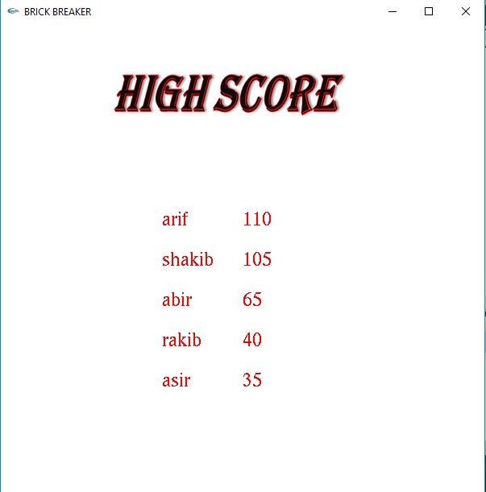
High Score

Slide 11
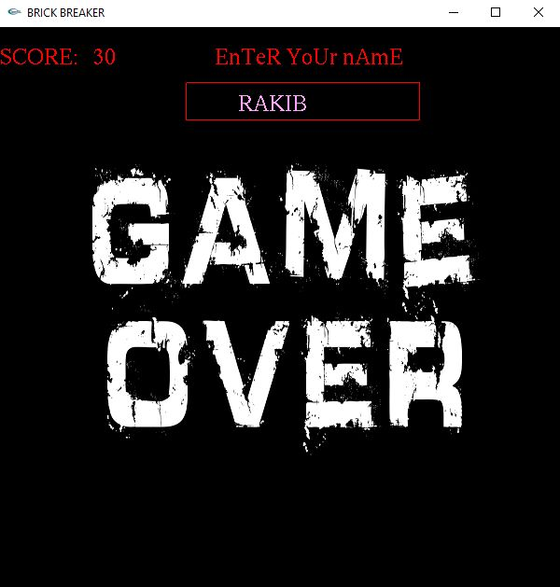
Game Over

Slide 12
System Requirements
For Development
For Playing
Windows 7,8,10
Microsoft visual studio 2010
Igraphics
Different graphic tools
Adobe Photoshop
Adobe illustrator
PC
Windows 7,8,10
Microsoft visual studio 2010

Slide 13

Thank you all

